Slide 1
Unicast Routing

Slide 2
General Idea
In unicast routing, a packet is routed,
hop by hop, from its source to its destination by the help of forwarding tables
only the routers that glue together the networks in the Internet need forwarding tables.

Slide 3
Least-Cost Routing
The best route from the source router to the destination router is to find the least cost between the two
In other words, the source router chooses a route to the destination router in such a way that the total cost for the route is the least cost among all possible routes

Slide 4
What does it mean to be the shortest (or optimal) route?
Minimize mean packet delay
Maximize the network throughput
Minimize the number of hops along the path
Dijkstra algorithm:
Each node is labeled (in parentheses) with its distance from the
source node along the best known path.
Initially, no paths are known, so all nodes are labeled with infinity.
As the algorithm proceeds and paths are found, the labels may
change, reflecting better paths.
A label may be either tentative or permanent.
Initially, all labels are tentative.
When it is discovered that a label represents the shortest possible path from the source to that node, it is made permanent and never changed thereafter.

Slide 5
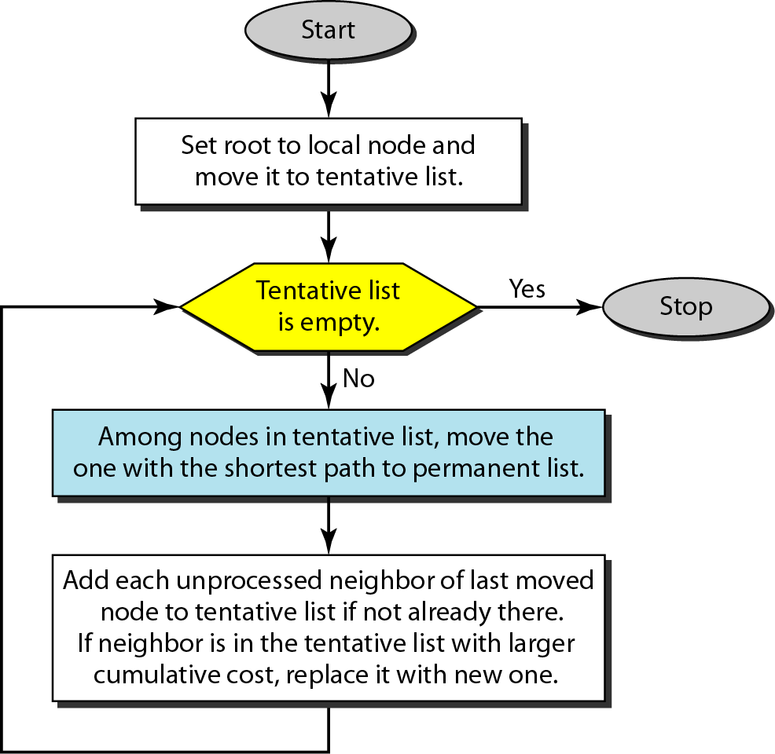
Dijkstra algorithm

Slide 6
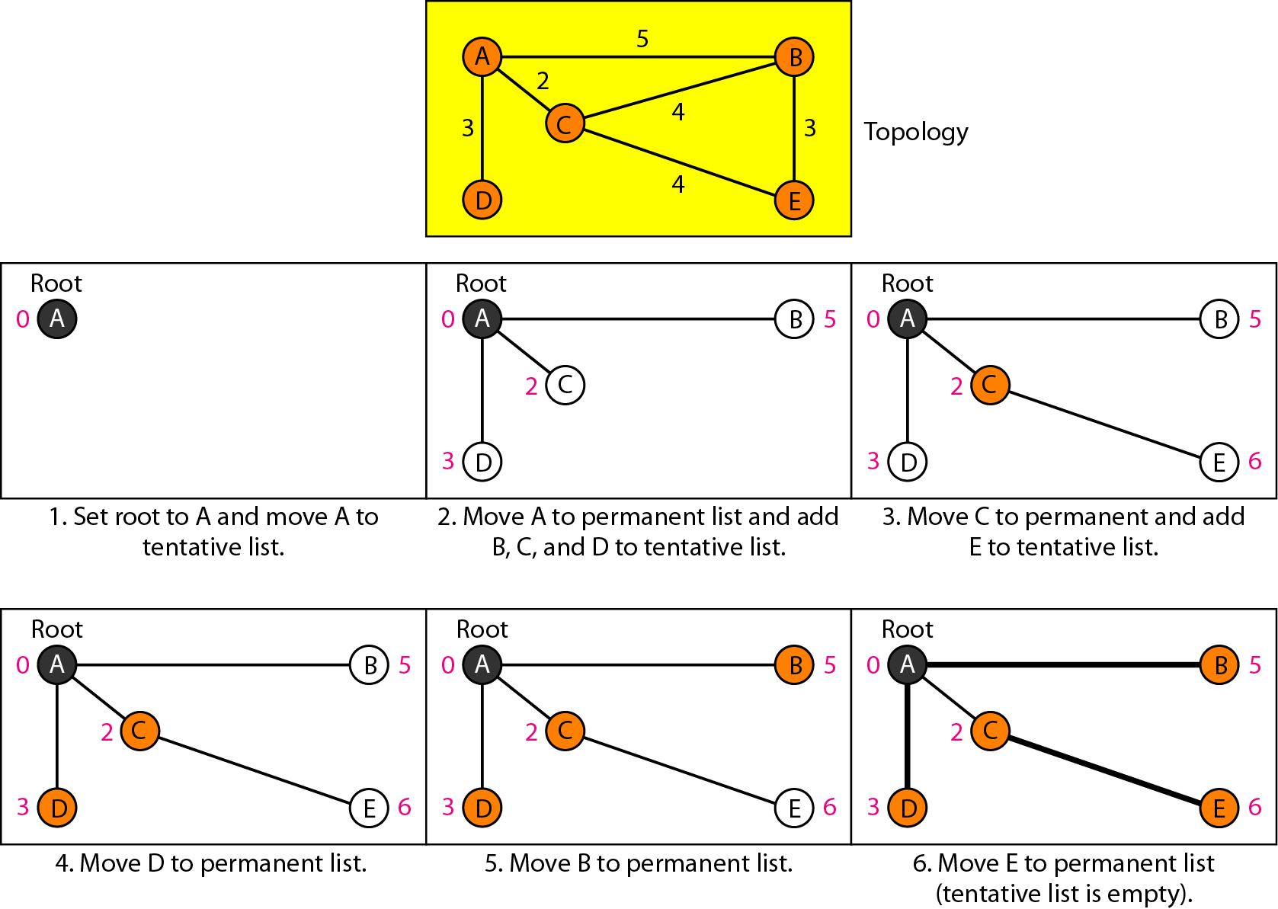
Figure 22.23 Example of formation of shortest path tree

Slide 7
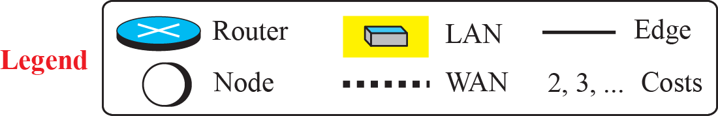
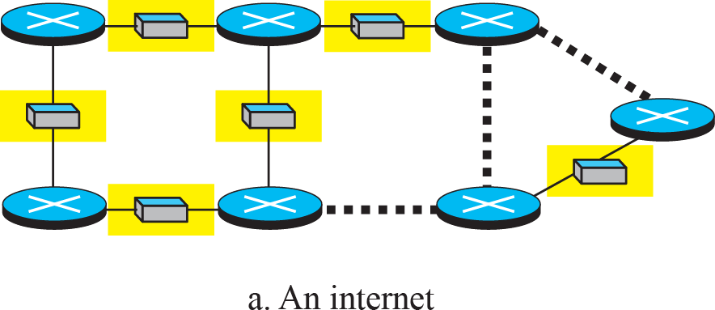
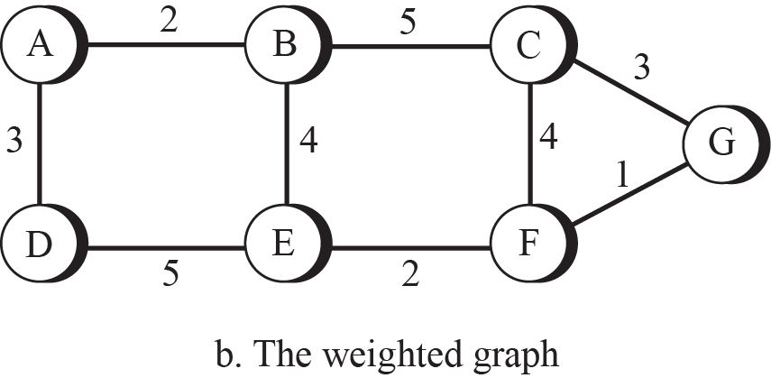
An internet and its graphical representation

Slide 8
Distance Vector Routing
- a router continuously tells all of its neighbors what it knows about the whole internet (although the knowledge can be incomplete)
Dynamic routing
A.k.a Bellman-Ford or Ford-Fulkerson algorithm
Each router maintains routing table with one entry per router in the subnet
Entry contains – preferred output line for a destination and estimate of time or distance to that destination
Metric – hops, time delay, number of packets queued, etc

Slide 9
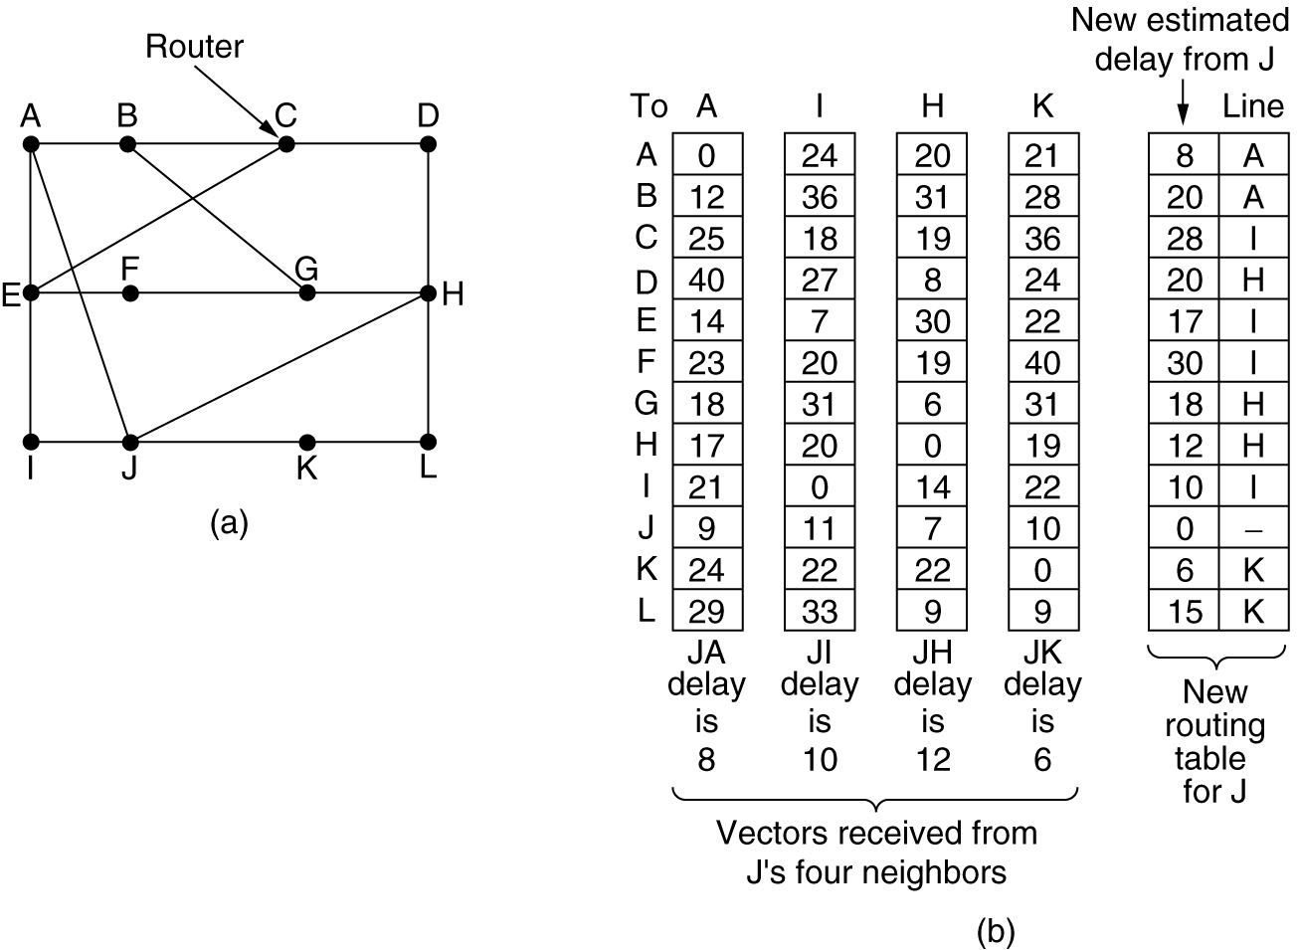
Distance Vector Routing
(a) A subnet. (b) Input from A, I, H, K, and the new
routing table for J.

Slide 10
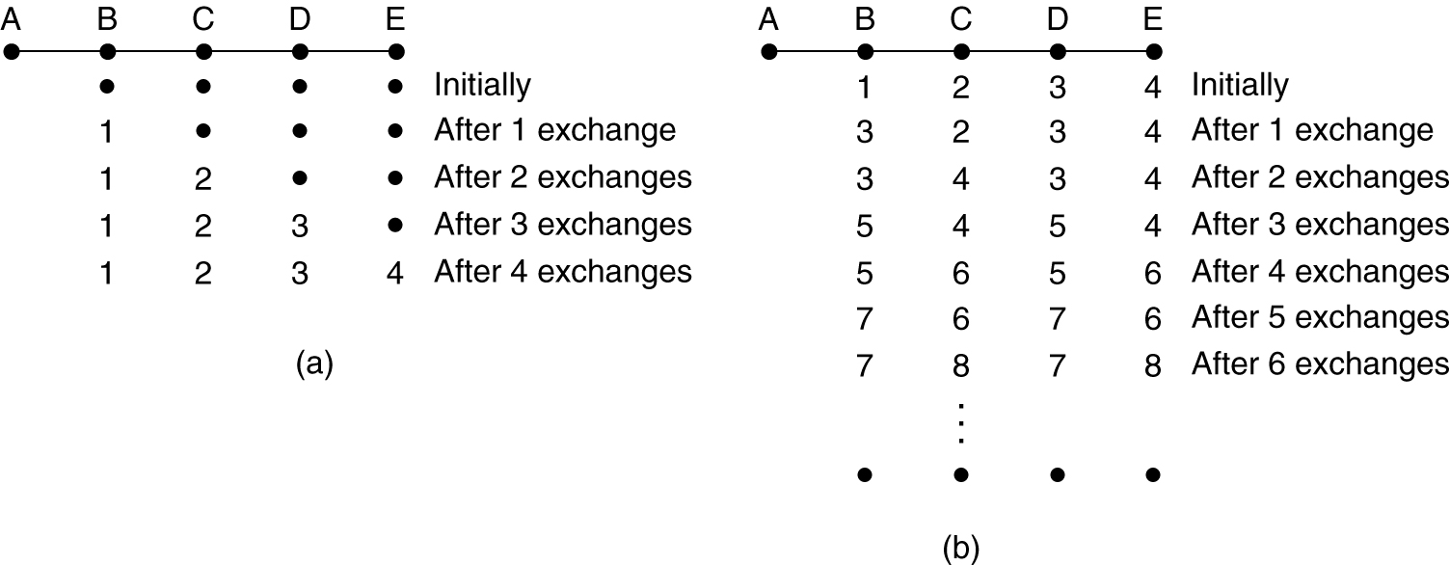
Distance Vector Routing count-to-infinity problem
Reacts rapidly to good news but leisurely to bad news
The count-to-infinity problem.

Slide 11
Link-State Routing
the cost associated with an edge defines the state of the link
Links with lower costs are preferred to links with higher costs
if the cost of a link is infinity, it means that the link does not exist or has been broken.

Slide 12
Link State Routing
Each router must do the following:
Discover its neighbors, learn their network address.
Measure the delay or cost to each of its neighbors.
Construct a packet telling all it has just learned.
Send this packet to all other routers.
Compute the shortest path to every other router.

Slide 13
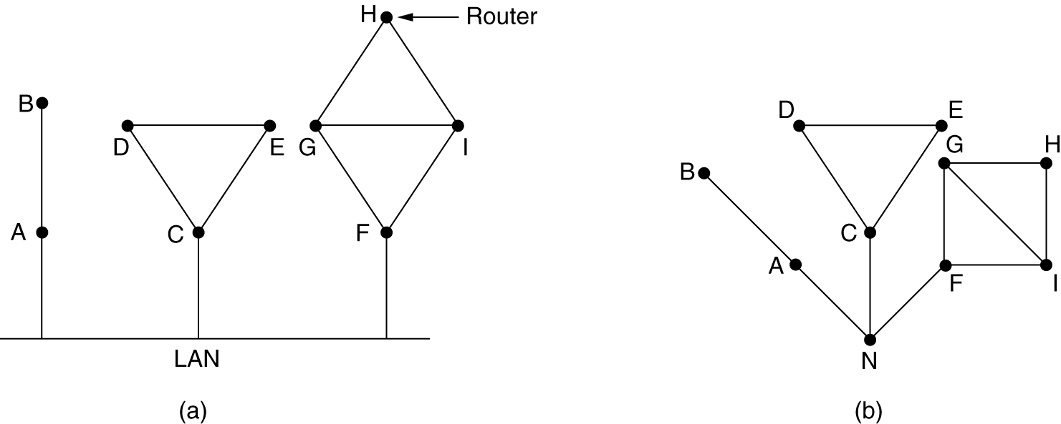
Learning about the Neighbors
Router sends an ECHO packet on each point to point line
The router on the other end replies back telling who it is
(a) Nine routers and a LAN. (b) A graph model of (a).

Slide 14
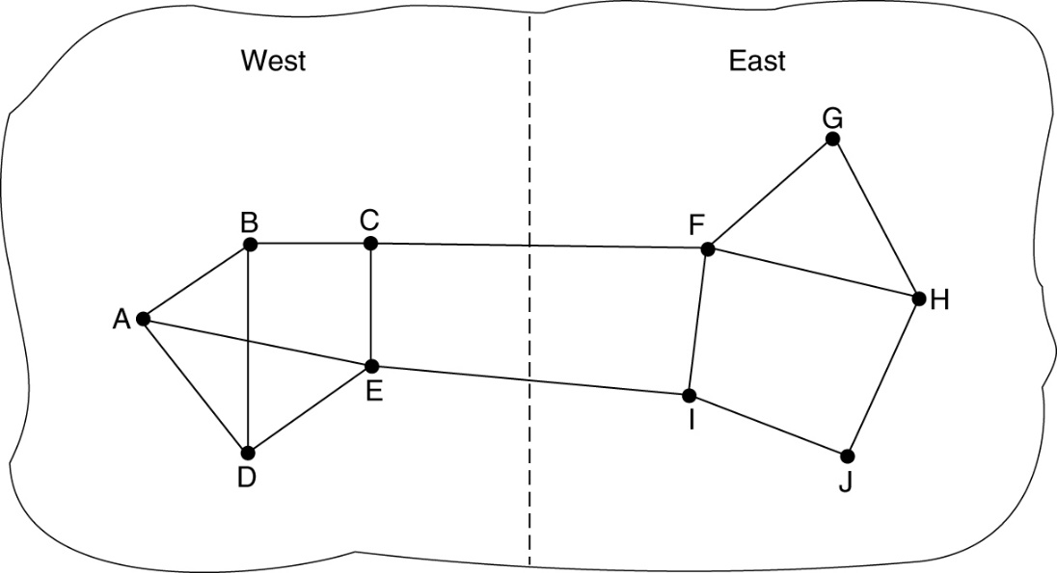
Measuring Line Cost
Measure the round trip time of ECHO pkt and half of it can be taken as the estimate of delay
If load is taken into account timer starts when ECHO pkt is queued, else timer starts when ECHO pkt reaches front of queue

Slide 15
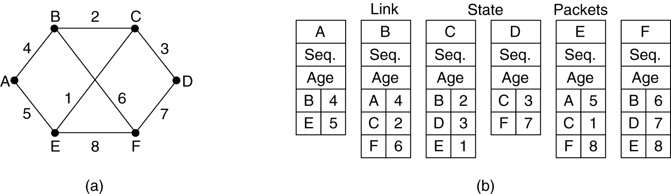
Building Link State Packets
Packet starts with
Identity of sender
Sequence number
age
List of neighbours, for each neighbor delay to that neighbor is given
Pkts are build periodically or when a significant event occurs
(a) A subnet. (b) The link state packets for this subnet.

Slide 16
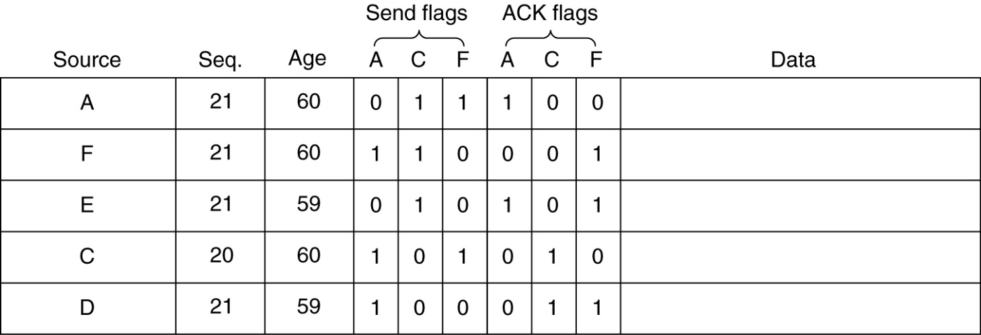
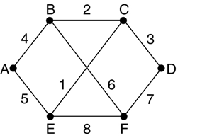
Distributing the Link State Packets
Use Flooding to distribute link state packets
Each pkt contains seq number that is incremented for each new pkt that is sent
Problems that can arise:
If seq number wrap around it will create confusion
If a router crashes it will lose track of sequence numbers, it will restart at 0
If a sequence number is corrupted, it will reject valid packets
The packet buffer for router B

Slide 17
UNICAST ROUTING PROTOCOLS
three common protocols used in the Internet:
Routing Information Protocol (RIP), based on the distance-vector algorithm
Open Shortest Path First (OSPF), based on the link-state algorithm
Border Gateway Protocol (BGP), based on the path-vector algorithm

Slide 18
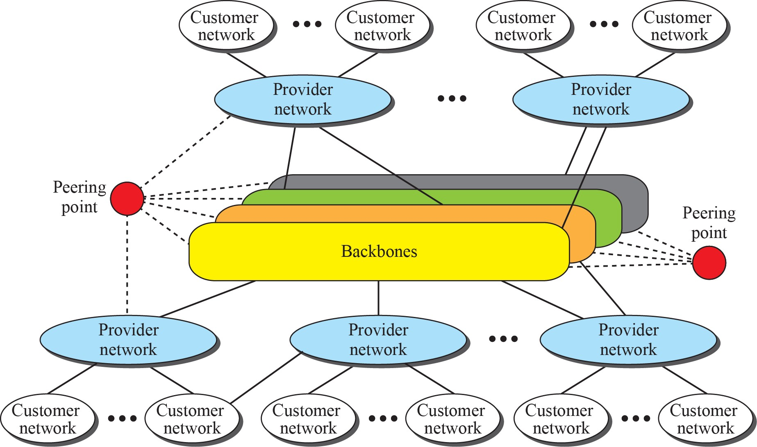
Internet structure

Slide 19
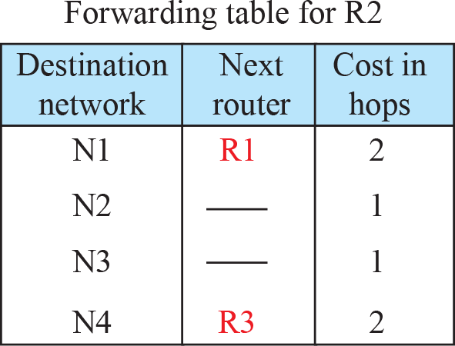
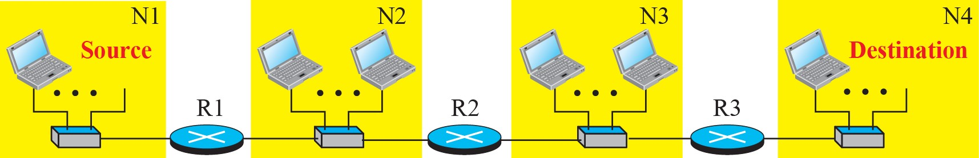
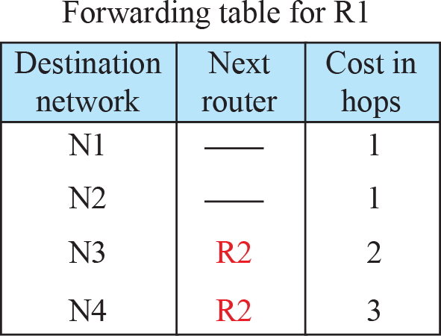
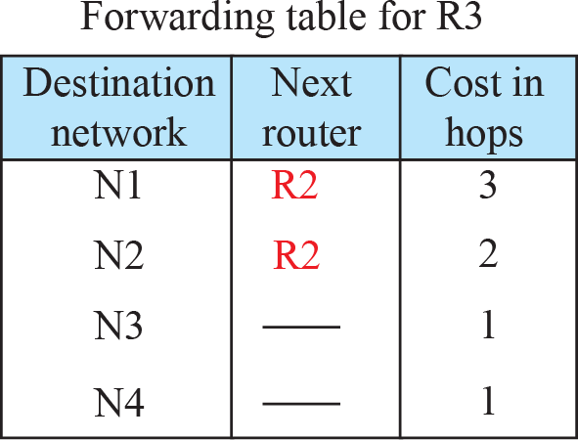
Hop counts in RIP
1 hop (N4)
2 H o p s (N 3 , N 4)
3
Hops (N2, N3, N4)

Slide 20
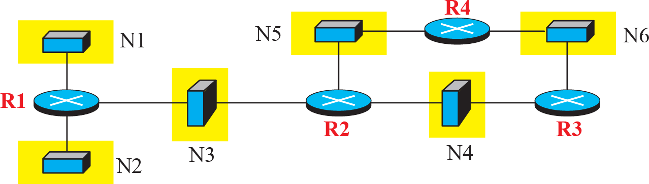
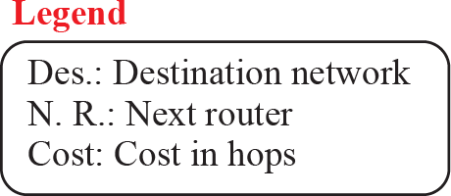
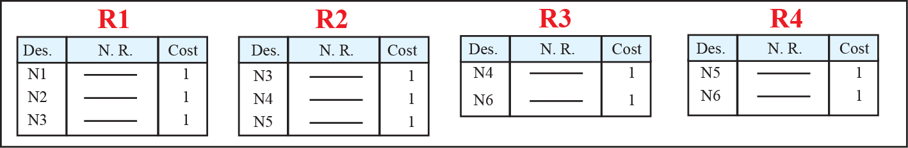
Example of an autonomous system using RIP (Part I)

Slide 21
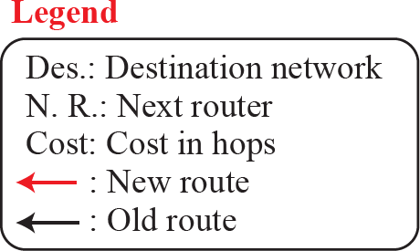
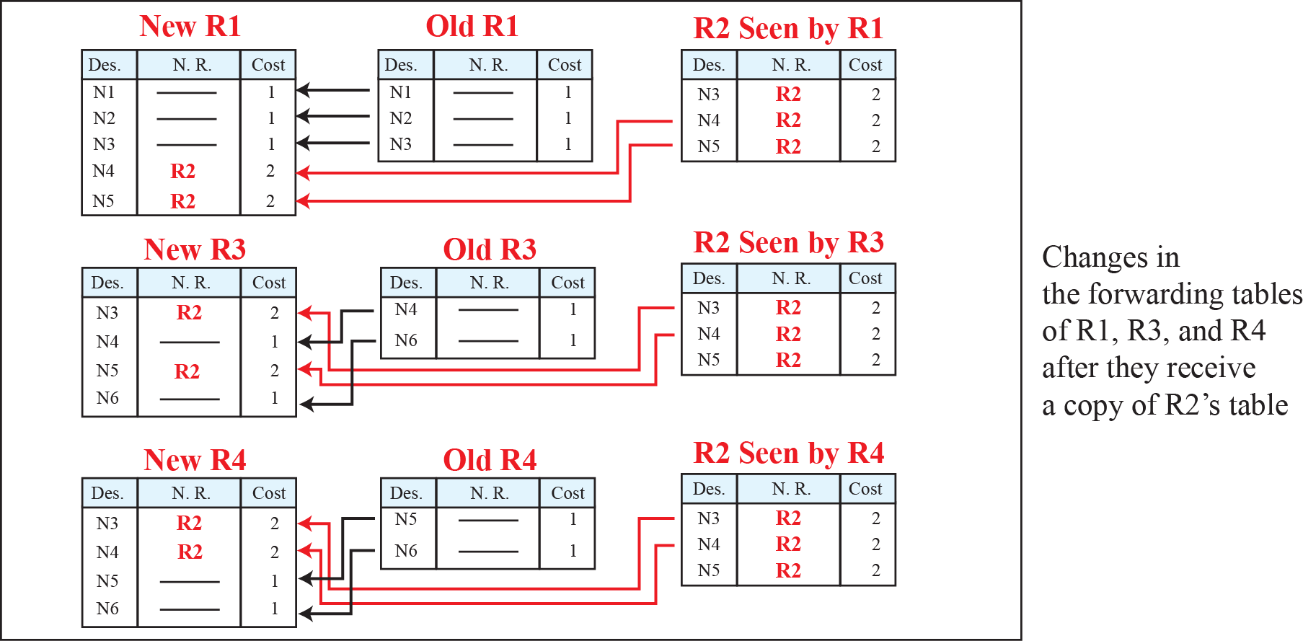
Example of an autonomous system using RIP (Part II)

Slide 22

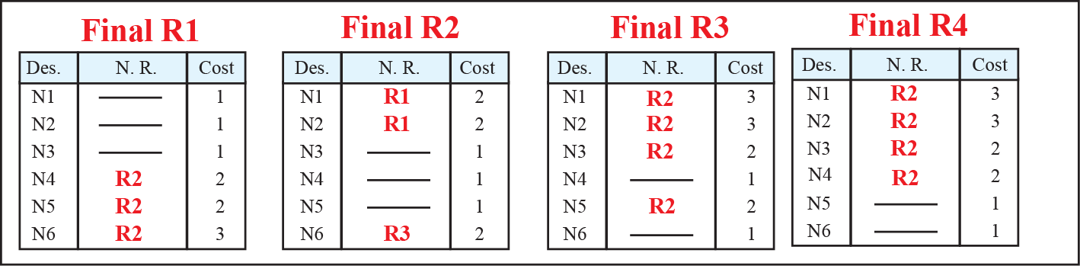
Example of an autonomous system using RIP (Part III)

Slide 23
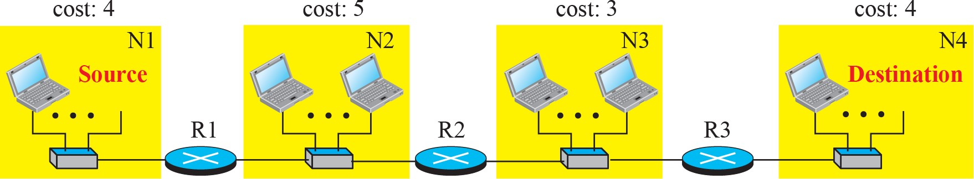



Metric in OSPF
Total cost: 4
Total cost: 7
Total cost: 12

Slide 24
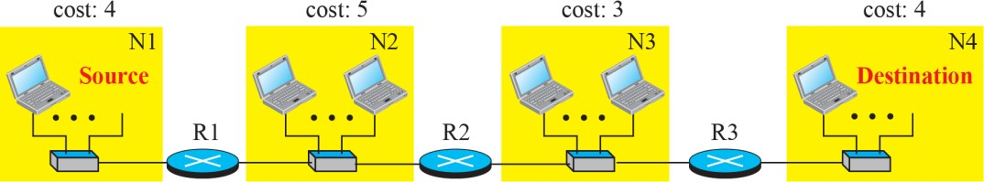
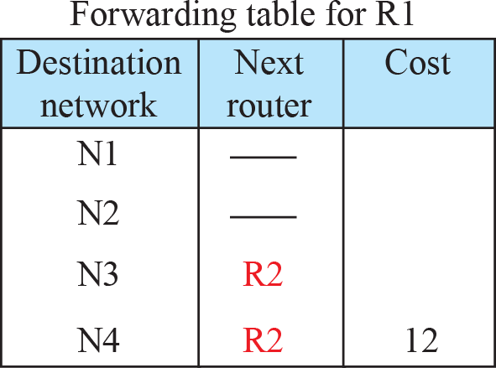
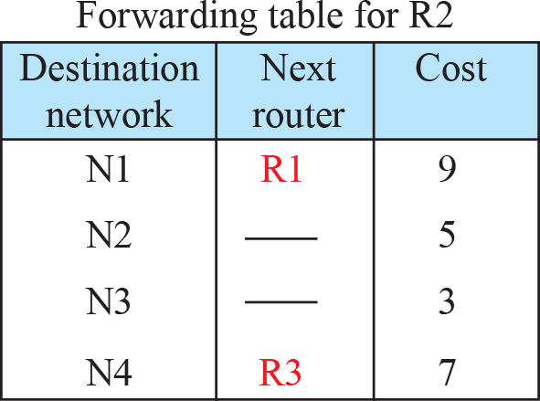
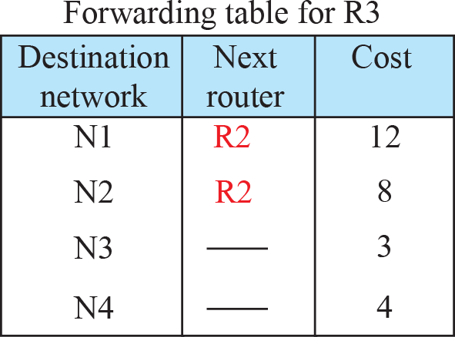
Forwarding tables in OSPF

Slide 25
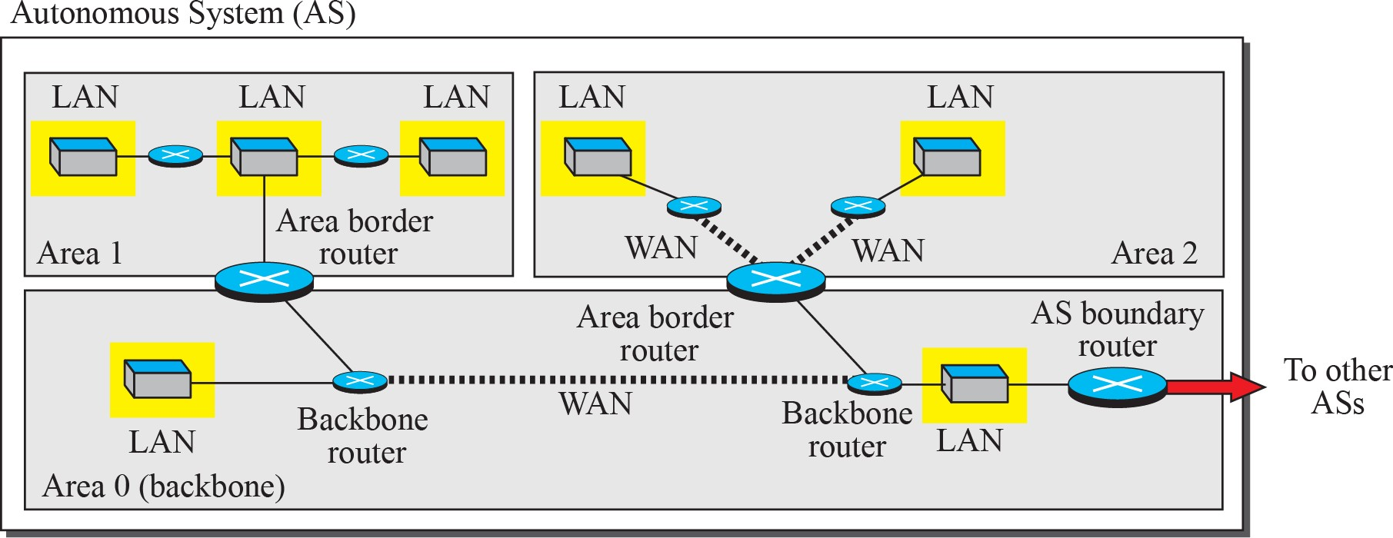
Areas in an autonomous system

Slide 26
Border Gateway Protocol
the only interdomain routing protocol used in the Internet today
is based on the path-vector algorithm
is tailored to provide information about the reachability of networks in the Internet.

Slide 27
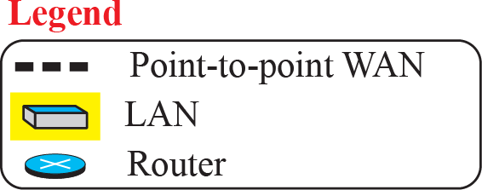
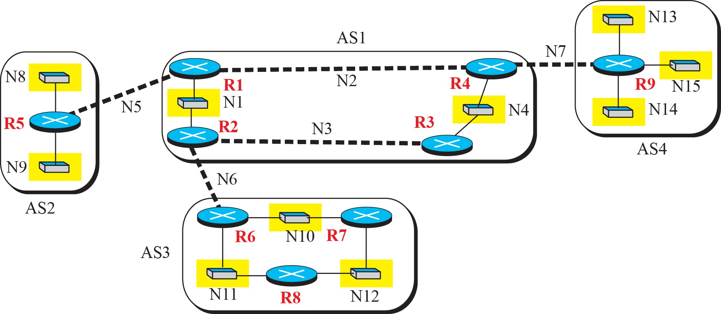
A sample internet with four ASs

Slide 28
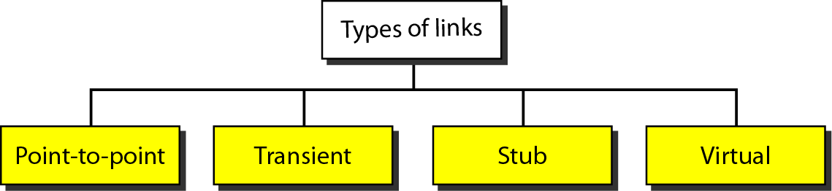
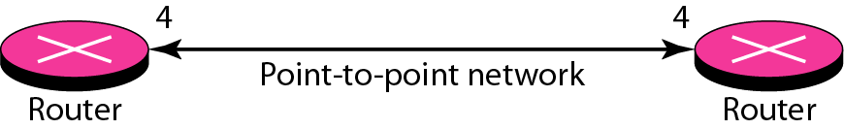
Types of links
Point-to-point link

Slide 29
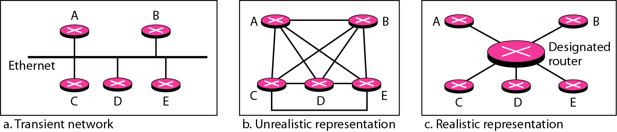
Transient link
If there lies a large number of routers attached to a network.
There can be Lan, wifi, several different routers then this configuration is termed as transient link.

Slide 30
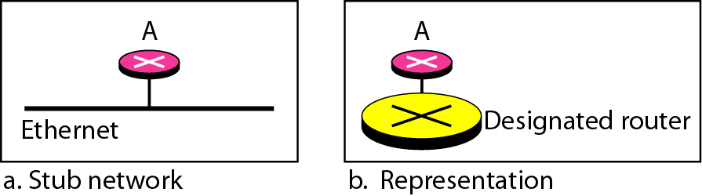
Stub link
It is a network that is connected with a single network.
The data packets are sent and received are through the same router.
Virtual link:
There may be some situation that arises when the link is broken due to some reason.
At that time the network administrator creates a virtual link between the two communicating routers.

Slide 31
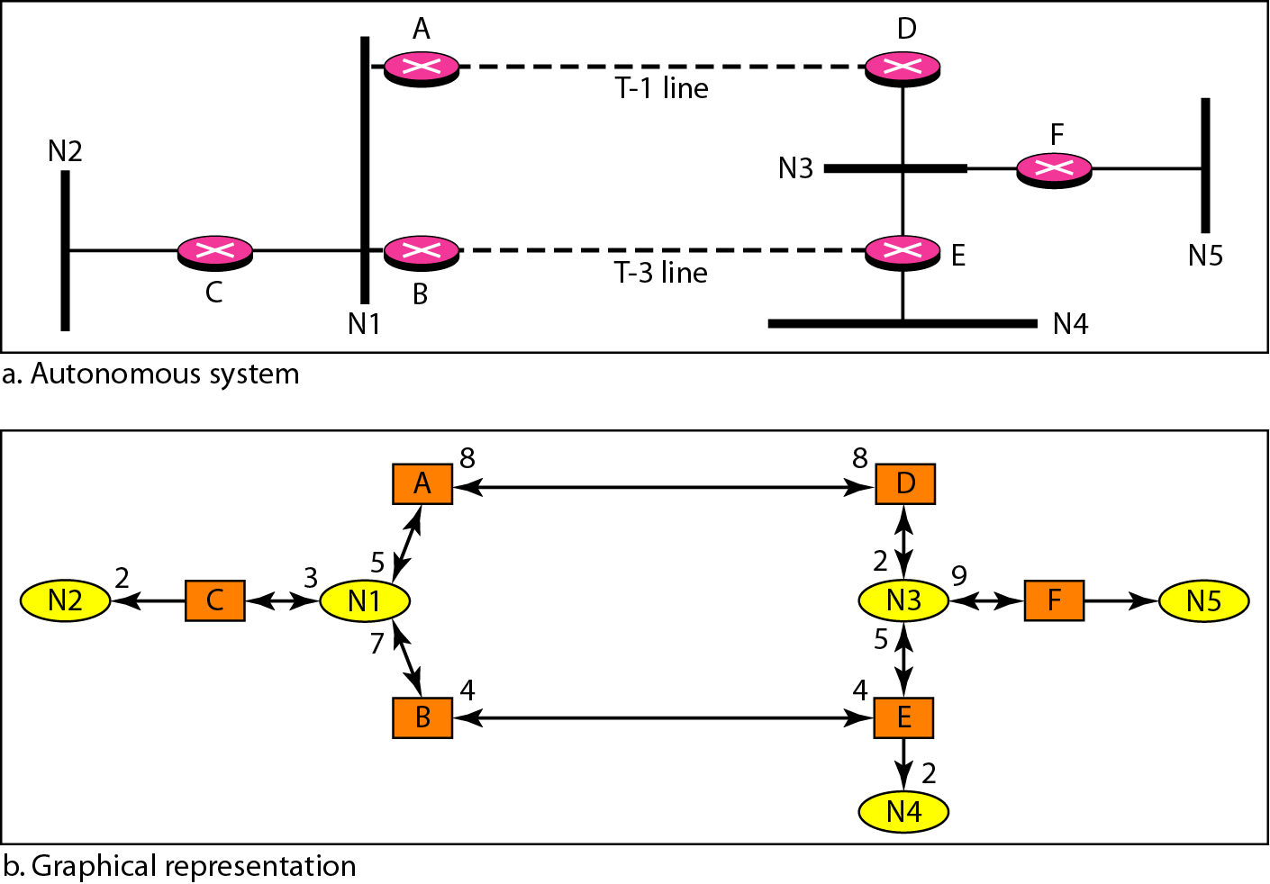
Example of an AS and its graphical representation in OSPF

Slide 32
Path Vector Routing
similar to distance vector routing
One node in each AS that acts as on behalf of the entire AS : Speaker Node
Speaker node creates a routing table and advertises it speaker nodes in the neighboring ASs advertising the path, not the metric of the nodes
each speaker node can know only the reachable of nodes inside its autonomous system.

Slide 33
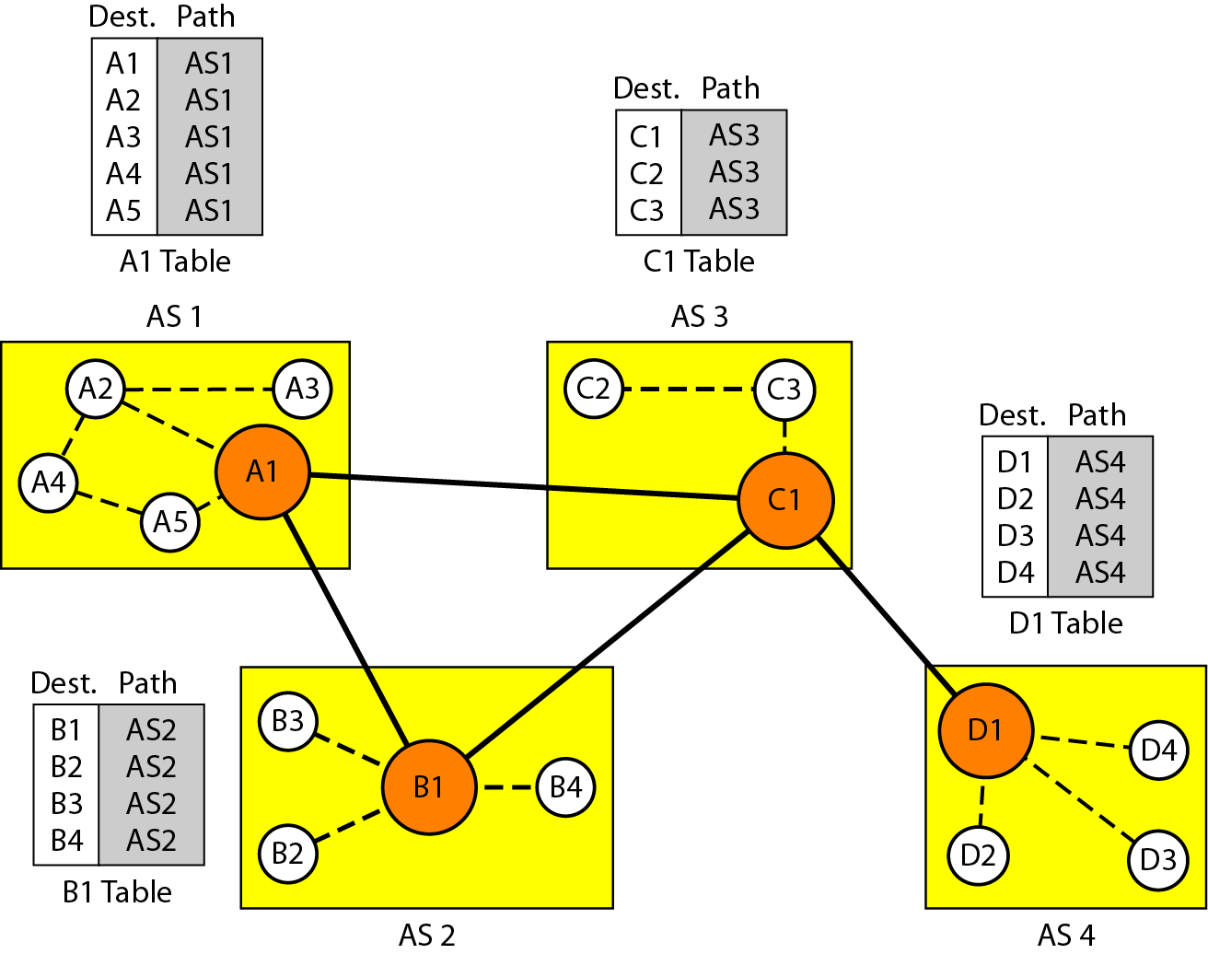
Initial routing tables in path vector routing

Slide 34
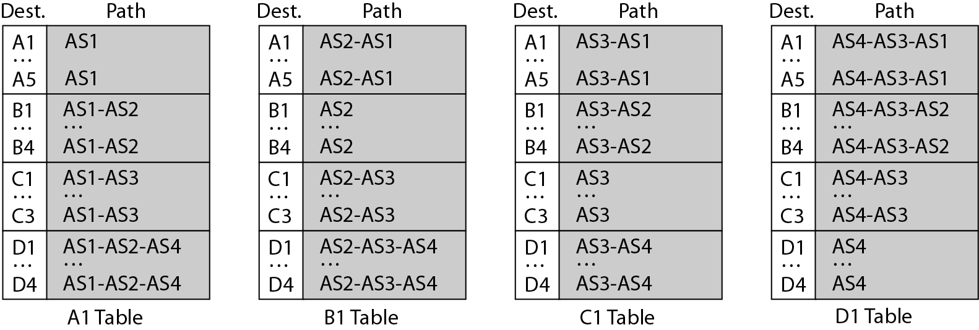
Figure 22.31 Stabilized tables for three autonomous systems

Slide 35
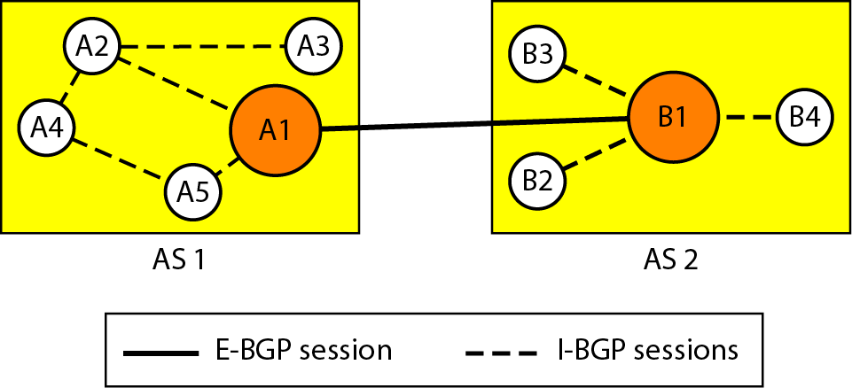
Figure 22.32 Internal and external BGP sessions

Slide 36
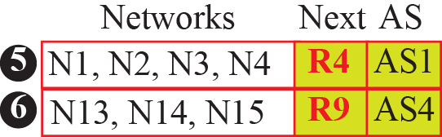
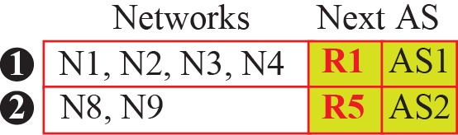
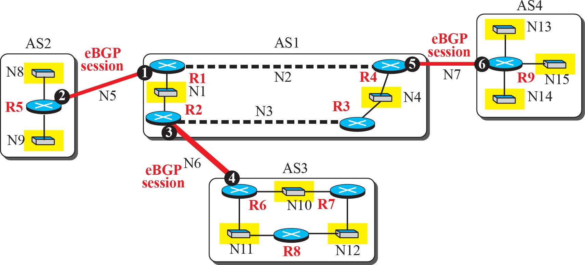
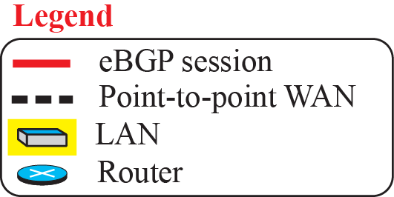
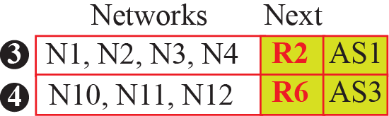
eBGP operation

Slide 37
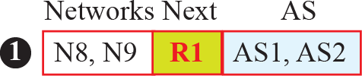
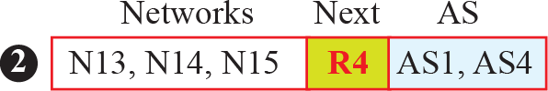
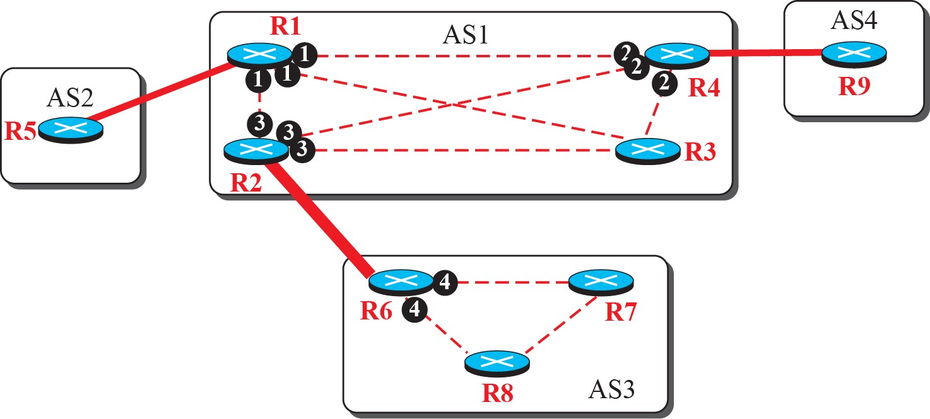
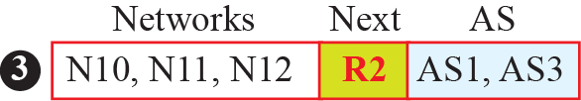
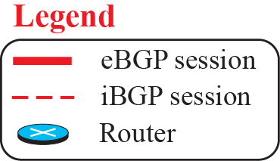
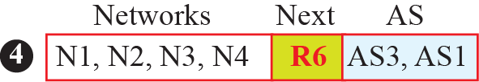
Combination of eBGP and iBGP sessions in our internet

Slide 38




Finalized BGP path tables (Part I)

Slide 39




Finalized BGP path tables (Part II)

Slide 40


Tunneling
Tunneling a packet from Paris to London.

Slide 41

Fragmentation
When large packets wants to travel through network with small packet size
Allow gateways to breakup packets to fragments
Send each fragment as separate internet packet
Defragment at exit or destination
Transparent fragmentation. (b) Nontransparent fragmentation.

Slide 42

Fragmentation
Fragmentation when the elementary data size is 1 byte.
(a) Original packet, containing 10 data bytes.
(b) Fragments after passing through a network with maximum packet size of 8 payload bytes plus header.
(c) Fragments after passing through a size 5 gateway.

